Slide 1


“Hardening the Weather Pipeline to Improve Accuracy in Crop Yield Forecasting- Part II”
Rainfall Prediction for GaiaDhi
Team 7 :
Laxmi Priya Venkateswaran
Ashwini Amaranatha
Shruthi Srinivasa Murthy
Md Zahidur Rahman Farazi

Slide 2

Introduction
This capstone project, undertaken as part of the coursework for GaiaDhi, aims to further enhance the integration of advanced weather data into agricultural decision-making processes.
The project is part of GaiaDhi’s Holos platform, which integrates crop science with machine learning for sustainable farming.
By applying machine learning techniques, the project aims to predict IMD precipitation values based on NASA Power API data, bridging the gap between global and localized weather information.

Slide 3

Project Objective
To build a robust predictive model, utilize geographical coordinates, meteorological factors (e.g., temperature, humidity), and temporal attributes (e.g., month,season).
To estimate missing IMD rainfall data using both the traditional Bias Function Model and Machine Learning Model.
To compare the accuracy of both models by evaluating error rates (bias error rate and ML error rate) to determine the more reliable approach.
To analyze the relationship between NASA precipitation, humidity, temperature, geographical distance (from the equator and meridian), and seasonal factors in predicting IMD rainfall.

Slide 4


Data Sources
NASA Power API
The NASA Power API offers access to global climatological data, which we used to obtain daily weather metrics relevant to our study.
Though it is global weather data but may lack localization accuracy.
IMD (Indian Meteorological Department)
The IMD provides localized historical weather data crucial for understanding regional climatic conditions across India.
The assumption is that this data is ground truth.

Slide 5

Data Description
Sl | Variable | Description | Source | Used in
1 | Date | Day of month | NASA & IMD | Bias and ML
2 | Latitude | Geographical location | NASA & IMD | Bias and ML
3 | Longitude | Geographical location | NASA & IMD | Bias and ML
4 | Precipitation(mm)_NASA | Rainfall as measured by NASA | NASA | Bias and ML
5 | Temperature(T2M) | Average air temperature | NASA | ML
6 | Humidity(RH2M) | Humidity at weather | NASA | ML
7 | Precipitation(mm)_IMD | Rainfall as measured by IMD | IMD | Bias and ML
Data Summary:
Columns: The dataset contains 7 columns.
Data Point: The number of data points in the dataset is 204,521
Type: It includes 1 categorical variables, 6 numerical variables
Date Range: Covers January 1, 2010, to December 31, 2023
Location Range: Latitude concentrated between 10.5 to 11.2 and Longitude concentrated between 79.3 to 79.7

Slide 6
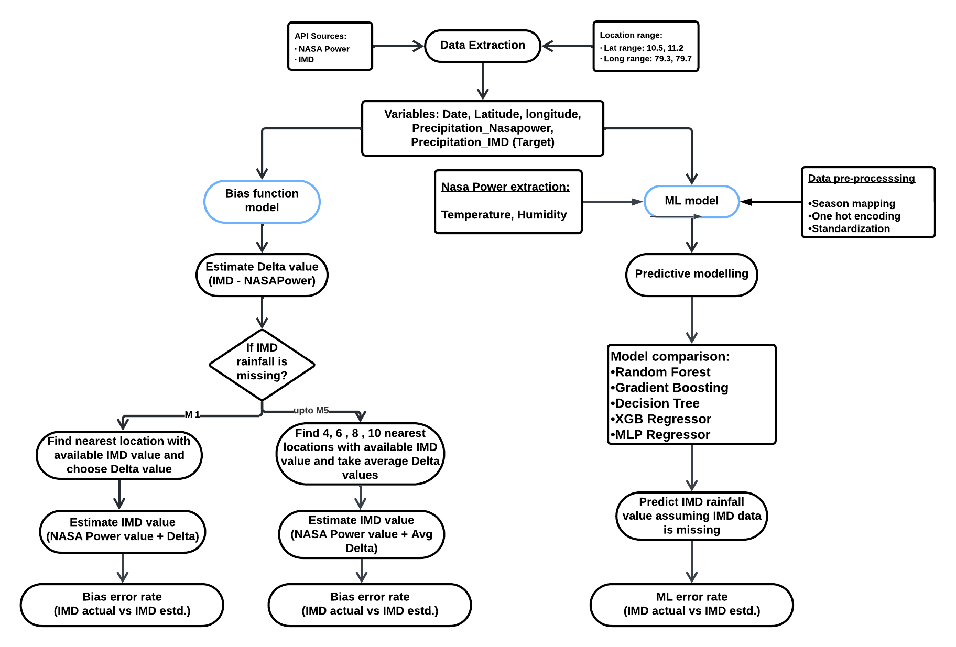
Project Framework

Slide 7

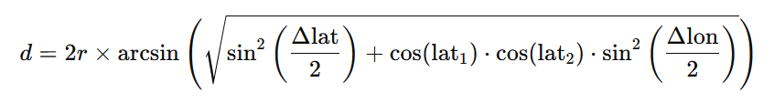
Bias Function Model
This is a traditional approach to predict IMD precipitation for a location where IMD data is missing.
Under this approach we have used Haversine formula to measure the distance between two geographical points defined by their latitude and longitude (Anchor Points).
Steps to Implement:
  Convert the latitude and longitude from degrees to radians.
  Apply the Haversine formula to calculate the distance.
  Compute the Haversine distance from the given Anchor Point to each other Anchor Point in our data.
  Sort the distances in ascending order.
  The smallest distances correspond to the nearest Anchor Points.
  Add Delta to NASA precipitation of the nearest point to find IMD precipitation

Slide 8
Bias Function Results
Method | Mean Squared Error (MSE) | Root Mean Squared Error (RMSE) | Mean Absolute Error (MAE) | R-squared (R²) | Duration (minutes)
Single Nearest Location | 22.1117 | 4.7023 | 0.9837 | 0.8487 | 8.251
4 Nearest Locations | 15.5676 | 3.9456 | 1.1789 | 0.8935 | 10.457
6 Nearest Locations | 19.9356 | 4.4649 | 1.3885 | 0.8636 | 10.767
8 Nearest Locations | 19.9124 | 4.4623 | 1.4081 | 0.8638 | 8.406
10 Nearest Locations | 21.1590 | 4.5999 | 1.4572 | 0.8553 | 7.406

Slide 9
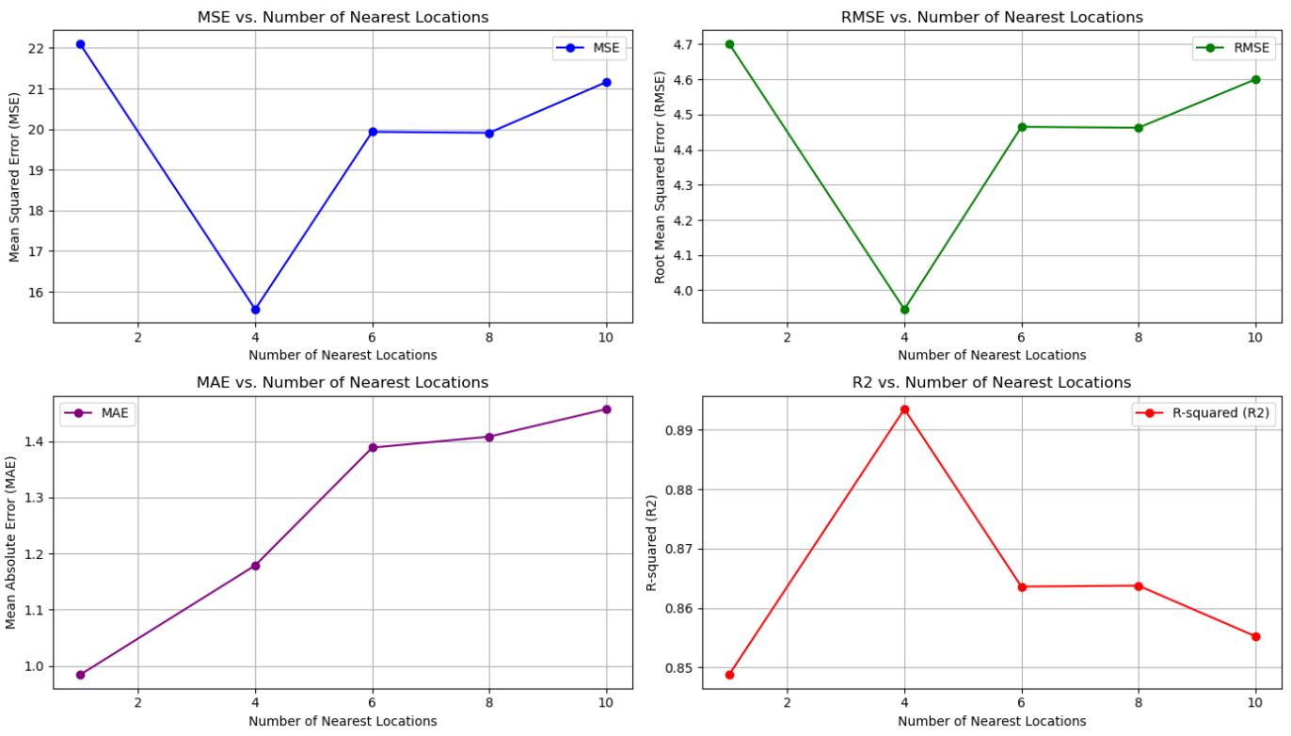
Bias Function Results

Slide 10
Bias Model Interpretation
The choice of method should depend on customer requirements:
For small regions where precision is critical, use the Single Nearest Location Method.
For larger regions, where an overall understanding of rainfall patterns is needed, the Four Nearest Locations Method would be best.

Slide 11

Machine Learning Model
To predict IMD precipitation we have tried to develop the following five different types of Machine Learning models:
  Random Forest Regressor
  Gradient Boosting Regressor
  Decision Tree Regressor
  Extreme Gradient Boosting (XGBRegressor)
  The Multi-Layer Perceptron (MLP) Regressor

Slide 12

Features Selection
Input Features/Variables
Date (Season)
Output/Target Variables
Precipitation_IMD
Latitude
Longitude
Temperature(T2M)
Humidity(RH2M)
Precipitation(mm)_NASA

Slide 13
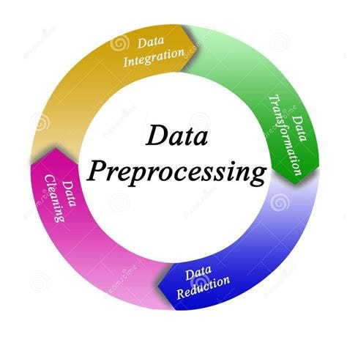
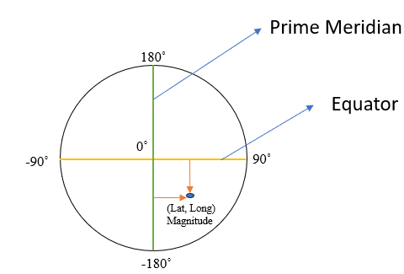
Pre-processing Steps
Season Mapping
Winter: January, February, and December
Pre- Summer: March and April
Summer: May and June
Southwest Monsoon: July and August
Autumn: September and October.
Northeast Monsoon: November
One-Hot Encode Season
Distance Calculations
Latitude into Distance_from_equator : It’s commonly used as a feature to capture latitudinal climate effects.
Longitude into Distance_from_meridian: Serves as the reference point for measuring longitude
Scale Numerical Features
Convert categorical variables (like season) into numerical format
Standardize the data to prepare it for machine learning models

Slide 14

Models and Hyperparameter Tuning
1.Models Evaluated:
RandomForest, GradientBoosting, DecisionTree, XGBoost, and MLPRegressor.
2. Hyperparameter Tuning:
Optimized using RandomizedSearchCV for key parameters: `n_estimators`, `max_depth`, `learning_rate`, and others.
3. Evaluation Metrics:
Performance assessed using:
Mean Squared Error (MSE)
Root Mean Squared Error (RMSE)
Mean Absolute Error (MAE)
R² (R-squared).

Slide 15
ML Models Results and Comparison
ML Models | MSE | RMSE | MAE | R2 | Duration (minutes)
Random Forest | 13.89 | 3.72 | 0.96 | 0.91 | 4.3093
Decision Tree | 17.88 | 4.23 | 0.64 | 0.88 | 1.083
Gradient Boost | 74.76 | 8.64 | 3.93 | 0.51 | 0.0251
XGBoost | 76.81 | 8.76 | 3.97 | 0.49 | 0.0575
MLP Regressor | 99.64 | 9.98 | 4.43 | 0.35 | 2.5825

Slide 16
Best Model
Random Forest Evaluation
  Mean Squared Error (MSE): 13.895028
  Root Mean Squared Error (RMSE): 3.724920(indicates the smallest prediction errors)
  Mean Absolute Error (MAE): 0.956140(smallest average absolute prediction error)
  R-squared (R2): 0.909293 (shows the model explains 91% of the variance in the target variable)
Evaluated model performance using key metrics: MAE, MSE, and R2
Robust Performance: Lowest error metrics (MSE, RMSE, MAE) and highest R².
Overfitting Avoidance: Performs well on unseen data due to its ensemble nature.
Feature Importance: Provides insights into the significance of predictors.
RandomForest effectively balances accuracy and reliability, making it the best model for this task.

Slide 17
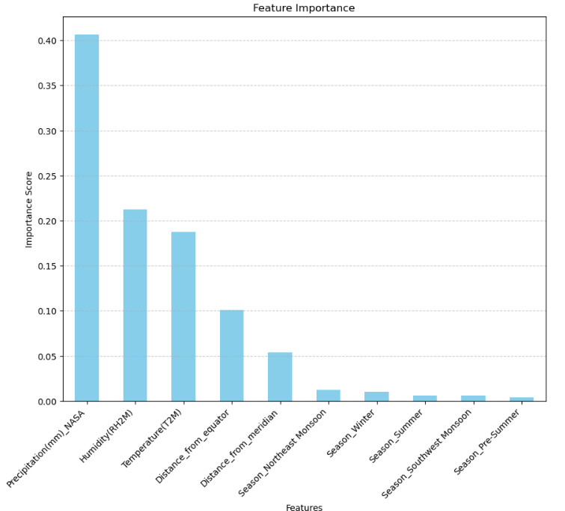
Feature Importance
Precipitation(mm)_NASA (Score: 0.405517)
Humidity(RH2M) (Score: 0.209639)
Temperature(T2M) (Score: 0.187296)
Distance_from_equator (0.101291)
Distance_from_meridian (0.053429)
Seasonal Features
Season_Northeast Monsoon: (Score: 0.010228)
Season_Winter: (Score: 0.009676)
Season_Autumn: (Score: 0.008178)
Season_Summer: (Score: 0.005827
Season_Southwest Monsoon: (Score: 0.005129)
Season_Pre-Summer: (Score: 0.003789)

Slide 18
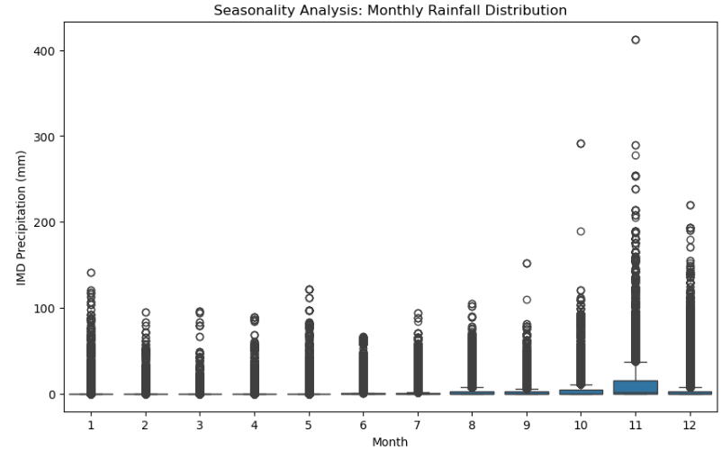
Seasonality Analysis
Peak Rainfall Period: November shows the highest rainfall and variability, making it a critical month for water-dependent crops.
Dry Season: January to April experience minimal rainfall, highlighting the need for irrigation planning.
Agricultural Alignment:
  Leverage peak rainfall for planting water-intensive crops like rice.
  Plan irrigation during dry months for crop sustainability.
Model Insights: Current focus on spatial resolution; short-term (monthly) trends are more precise, with potential for validating predictions against historical patterns.

Slide 19
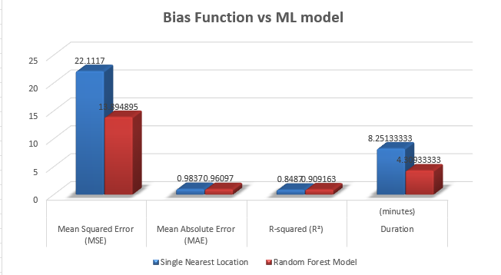
Model Comparison:
Bias Function VS Random Forest
Method | Mean Squared Error (MSE) | Mean Absolute Error (MAE) | R-squared (R²) | Duration (seconds)
Single Nearest Location | 22.1117 | 0.9837 | 0.8487 | 495.08 ~ 8.251 mins
Random Forest Model | 13.894895 | 0.960970 | 0.909163 | 258.56 ~ 4.309 mins

Slide 20
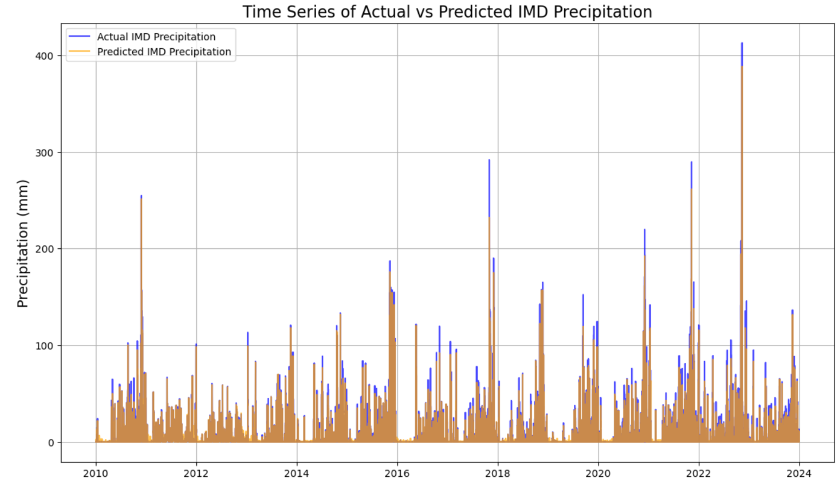
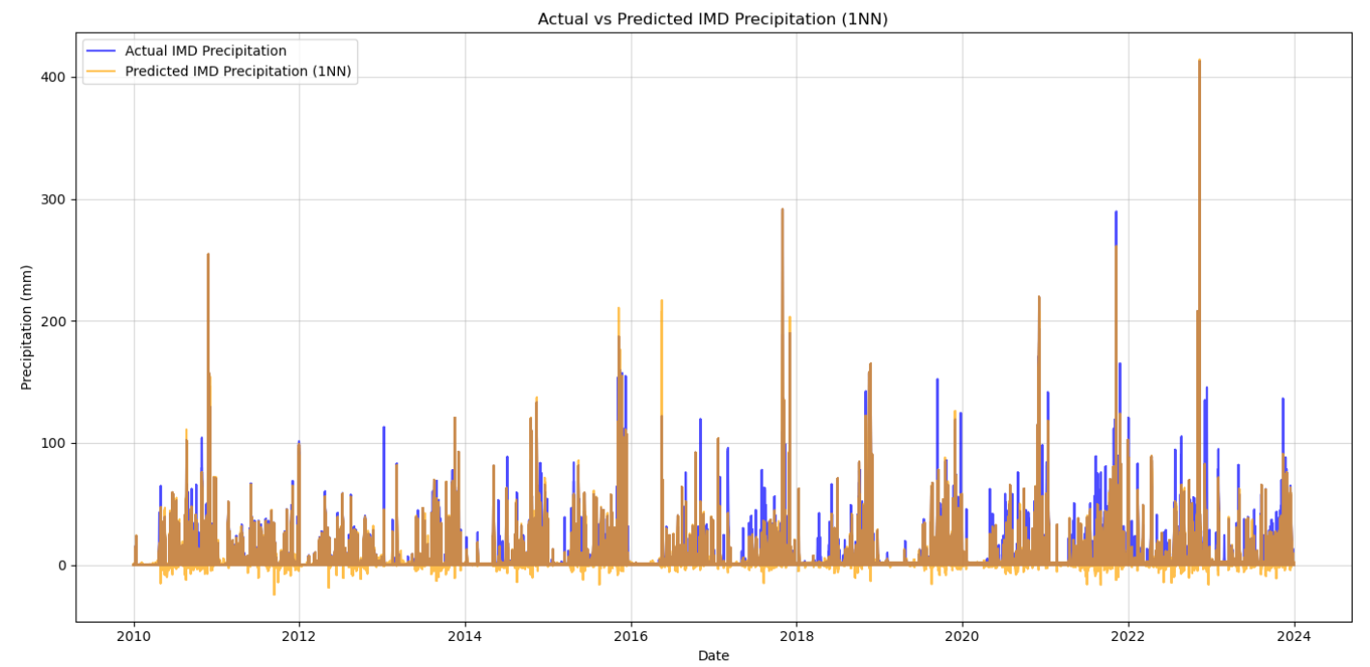
ML Model
Actual VS Predicted IMD Precipitation
Bias Function Model

Slide 21
Sample Results – Prediction of IMD precipitation
POI | Latitude | Longitude
TRRI Aduthurai Rice Research Station | 10.99923 | 79.4791
A farm | 11.1691 | 79.4791
TNAU Rice Research Station | 11.1691 | 79.53421
Two Approaches
Approach 1 : Test results within range of training dataset
  Date Search:
    User Input: The user will provide Latitude, Longitude and Date.
    System will automatically extract other input variables (Precipitation(mm)_NASA, Temperature(T2M), and Humidity(RH2M)) for the user given location and date.
    The best-trained model (Random Forest) predicts IMD precipitation based on the input features
  Season Search:
    User Input: Latitude, Longitude and Season
    System will automatically filter the dataset to retrieve other input variables (Precipitation(mm)_NASA, Temperature(T2M), and Humidity(RH2M)) records that match the user-specified latitude, longitude, and season
    Computes the average values for the filtered records. These averages serve as input features for the machine learning model.
    The trained best model predicts IMD precipitation based on the input features
Approach 2 : Test results outside the range of training dataset
  Date Search:
    User Input: Latitude, Longitude and Date
    The trained best model (Random Forest) predicts IMD precipitation based on the input features
  Season Search:
    User Input: Latitude, Longitude and Season
    The code filters the dataset to include only the rows corresponding to the given season
    If matching season exist, it calculates the average values for the required variables (Precipitation(mm)_NASA, Temperature(T2M), Humidity(RH2M)) from those filtered rows.
    The trained best model (Random Forest regressor) predicts IMD precipitation based on the input features

Slide 22
Results Comparison (ML vs Bias Function)
Approach 1 – Date search (Part A – User inputs: Latitude, Longitude and Date (Date Search)
Sl | User Input |  |  | These variables will be retrieved from system automatically |  |  |  | ML Model Result |  | Bias Function Result |  | Difference (ML - Bias)
 | Date | Latitude | Longitude | Precipitation NASA | Temperature (T2M) | Humidity (RH2M) | Precipitation IMD | Predicted IMD Precipitation | Error (Difference) | Predicted IMD Precipitation | Error (Difference)
1 | 2010-01-09 | 10.5 | 79.5 | 5.32 | 24.86 | 87.41 | 8.1282 | 7.8022 | 0.03260 | 5.2444 | 2.8837 | -2.8511
2 | 2010-01-08 | 10.7 | 79.7 | 12.7 | 25.9 | 88.88 | 2.9676 | 3.3489 | -0.3812 | 5.7562 | 2.7885 | -3.1697
3 | 2012-06-07 | 10.7 | 79.4 | 0.01 | 31.15 | 56.31 | 20.6259 | 20.1429 | 0.4830 | 20.6259 | 0 | 0.483
4 | 2015-07-29 | 10.7 | 79.7 | 5.69 | 28.9 | 79.19 | 1.3092 | 1.1241 | 0.185 | 2.9830 | -1.6738 | 1.8588
5 | 2014-11-04 | 10.9 | 79.5 | 3.37 | 24.47 | 83.25 | 5.2827 | 5.3575 | -0.0748 | 5.2827 | 0 | -0.0748
6 | 2010-01-10 | 11.1 | 79.7 | 3.22 | 25.70 | 89.56 | 6.5731 | 6.9129 | -0.3398 | 10.1672 | -3.5940 | 3.2542
7 | 2018-07-04 | 11 | 79.6 | 1.09 | 29.75 | 67.12 | 0 | 0 | 0 | 0 | 0 | 0
8 | 2023-12-31 | 11.2 | 79.7 | 0.15 | 26.22 | 77.25 | 0.1370 | 0.1464 | -0.009 | 2.6195 | -1.7687 | 1.7597
9 | 2017-06-15 | 10.9 | 79.6 | 1.24 | 30.66 | 66.5 | 2.2318 | 2.3431 | -0.1112 | 2.2318 | 0 | -0.1112
10 | 2018-03-21 | 10.8 | 79.5 | 0 | 29.31 | 60.44 | 0 | 0 | 0 | 0 | 0 | 0
11 | 2010-01-12 | 10.5 | 79.3 | 0.51 | 25.51 | 88.69 | 2.0782 | 1.8866 | 0.1916 | 1.6498 | 0.4284 | -0.2368
12 | 2010-05-05 | 10.5 | 79.7 | 4.05 | 30.8 | 75.56 | 10.5782 | 10.7599 | 0.1817 | 8.7840 | 1.7940 | -1.6123
13 | 2016-07-07 | 10.6 | 79.3 | 0.1 | 30.72 | 60.88 | 24.5160 | 23.1907 | 1.3253 | 25.1975 | -0.6815 | 2.0068
14 | 2021-08-15 | 10.6 | 79.7 | 5.42 | 29.29 | 72.62 | 3.2522 | 3.3083 | 0.0661 | 4.0075 | -0.7652 | 0.8313
15 | 2012-02-10 | 10.8 | 79.3 | 0.9 | 26.62 | 75.75 | 4.2188 | 4.0464 | 0.1723 | 3.9270 | 0.2918 | -0.1195

Slide 23
Approach 1: Test Results within the Range of Training Dataset
Part B – User inputs: Latitude, Longitude and Season (Season Search)
Season | Latitude | Longitude | Actual Precipitation (NASA) | Actual Temperature (T2M) | Actual Humidity (RH2M) | Actual Precipitation (IMD) | Predicted Precipitation (IMD) | Error (Difference)
Autumn | 11.2 | 79.3 | 4.825222482 | 28.23211944 | 75.195363 | 4.439078142 | 2.626925151 | -1.812152991
Autumn | 11.1 | 79.7 | 4.907997658 | 28.55818501 | 77.62299766 | 4.347148079 | 2.691859357 | -1.655288721
Autumn | 10.8 | 79.5 | 4.825222482 | 28.23211944 | 75.195363 | 5.104244962 | 4.202841355 | -0.901403608
Autumn | 10.7 | 79.6 | 4.881861827 | 28.53466042 | 74.85790398 | 5.104244962 | 2.283056407 | -2.821188556
Winter | 11 | 79.4 | 1.85557403 | 24.88204276 | 79.74679335 | 3.099790933 | 3.390687412 | 0.290896479
Winter | 10.7 | 79.6 | 2.156508314 | 25.30198733 | 79.8485194 | 3.287004233 | 8.038262623 | 4.751258389
Winter | 10.7 | 79.6 | 2.156508314 | 25.30198733 | 79.8485194 | 3.287004233 | 8.038262623 | 4.751258389
Winter | 10.8 | 79.7 | 2.133032462 | 26.00846397 | 78.14674584 | 3.796938964 | 7.811838573 | 4.014899609
NE Monsoon | 11 | 79.5 | 8.965690476 | 25.79740476 | 86.13802381 | 12.78022427 | 12.41185279 | -0.368371476
NE Monsoon | 10.8 | 79.6 | 8.965690476 | 25.79740476 | 86.13802381 | 12.50056435 | 7.886514301 | -4.614050044
NE Monsoon | 10.5 | 79.5 | 9.030238095 | 26.18961905 | 85.64738095 | 12.21846809 | 13.84903998 | 1.630571885
NE Monsoon | 11.1 | 79.6 | 8.965690476 | 25.79740476 | 86.13802381 | 12.78022427 | 13.09095915 | 0.310734886
SW Monsoon | 11.1 | 79.5 | 2.77593318 | 29.82260369 | 64.16794931 | 3.319908938 | 1.623929288 | -1.69597965
SW Monsoon | 10.6 | 79.4 | 2.461947005 | 29.97859447 | 64.72445853 | 3.507537709 | 3.945817196 | 0.438279487
SW Monsoon | 11.1 | 79.6 | 2.77593318 | 29.82260369 | 64.16794931 | 3.319908938 | 1.804110509 | -1.515798429
SW Monsoon | 10.5 | 79.4 | 2.461947005 | 29.97859447 | 64.72445853 | 3.507537709 | 4.050780232 | 0.543242523
Summer | 10.7 | 79.4 | 2.090468384 | 30.74117096 | 65.94407494 | 2.488839236 | 0.683811056 | -1.80502818
Summer | 10.5 | 79.6 | 2.090468384 | 30.74117096 | 65.94407494 | 2.528191979 | 0.804048352 | -1.724143628
Summer | 10.9 | 79.5 | 2.099063232 | 30.92512881 | 63.17261124 | 2.24074308 | 3.747197044 | 1.506453964
Summer | 11 | 79.5 | 2.099063232 | 30.92512881 | 63.17261124 | 2.24074308 | 3.770213048 | 1.529469969
Pre-Summer | 11.2 | 79.5 | 0.660456674 | 30.03449649 | 63.93384075 | 0.93105169 | 4.932631162 | 4.001579472
Pre-Summer | 11.2 | 79.6 | 0.660456674 | 30.03449649 | 63.93384075 | 0.93105169 | 4.932631162 | 4.001579472
Pre-Summer | 10.9 | 79.4 | 0.660456674 | 30.03449649 | 63.93384075 | 0.959608581 | 4.908826189 | 3.949217608
Pre-Summer | 10.9 | 79.6 | 0.660456674 | 30.03449649 | 63.93384075 | 0.959608581 | 4.901095484 | 3.941486902

Slide 24
Approach 2: Test Results Outside the Range of Training Dataset
Part A – User inputs: Latitude, Longitude and Date (Date Search)
Date | Latitude | Longitude | Precipitation (mm)_NASA | Temperature (T2M) | Humidity (RH2M) | Predicted Precipitation (IMD)
2020-11-09 00:00:00 | 10.999226 | 79.479101 | 0.08 | 26.96 | 75.69 | 3.130524272
2022-04-24 00:00:00 | 10.999226 | 79.479101 | 0.6 | 30.55 | 65.38 | 0.746203899
2015-07-09 00:00:00 | 11.1691 | 79.479101 | 0.15 | 31.83 | 56.44 | 1.574085521
2011-08-19 00:00:00 | 11.1691 | 79.479101 | 0.21 | 29.11 | 65.44 | 0.358699818
2023-10-01 00:00:00 | 11.1691 | 79.53421 | 0.53 | 29.65 | 67.56 | 0.851970982
2019-09-26 00:00:00 | 11.1691 | 79.53421 | 1.9 | 27.12 | 84.56 | 11.25315909

Slide 25
Approach 2: Test Results Outside the Range of Training Dataset
Part B – User inputs: Latitude, Longitude and Season (Season Search)
Season | Latitude | Longitude | Precipitation (mm)_NASA | Temperature (T2M) | Humidity (RH2M) | Predicted Precipitation (IMD)
Winter | 10.999226 | 79.479101 | 1.880340 | 24.878492 | 79.744386 | 2.629518548
Summer | 10.999226 | 79.479101 | 1.967553 | 30.303984 | 61.970756 | 3.943484159
Southwest Monsoon | 11.1691 | 79.479101 | 3.603984 | 29.142459 | 68.914766 | 16.09706863
Summer | 11.1691 | 79.479101 | 1.967553 | 30.303984 | 61.970756 | 3.300611846
Autumn | 11.1691 | 79.53421 | 7.463631 | 26.674842 | 82.521450 | 7.13497147

Slide 26

Interpretation
Interpretation of the Project:
Model relies on real-time weather data (NASA Precipitation, Humidity).
Spatial features, especially latitude, significantly affect predictions.
Seasonality helps but is less influential than meteorological data.
Interactions between weather and location are key for accurate rainfall predictions.

Slide 27
Limitations and Recommendations
Limitations
Limited Geographic Coverage
Recommendations
Use Random Forest as the primary model for better accuracy.
Seasonal Prediction Variability
Dependence on NASA Data Quality
Include more meteorological data for improved predictions.
Focus on improving predictions for high-rainfall months.
Develop user-friendly tools for farmers’ water and crop planning.

